Slide 1
Vision and Language
CSE 576
Instructor: Dr. Chitta Baral
Prepared By: Dr. Somak Aditya

Slide 2
Outline
Perspectives: How Language and Vision Interact
Scene Understanding using Language
Caption Generation from Images
Caption Generation from Videos
Current Technologies
RNN/LSTM to understand language
CNN to understand image

Slide 3
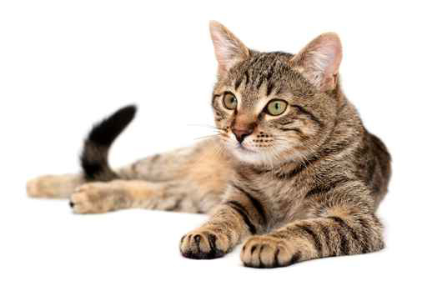
Perspectives: How Language and Vision Interact
Language Grounding to Images
Understand a word using an image.
Image Grounding to Language
Understand image using word(s).
Classification vs. Embedding
Cat
brown
Furry creature

Slide 4
Hypothesis: Image Understanding is only as powerful as the annotations we have.
Annotations are costly!
Notes:
Detect objects, generate captions -> you need annotated images.

Slide 5
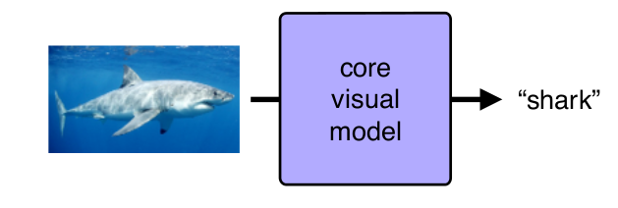
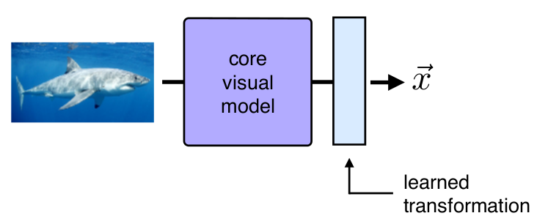
Image Understanding: Classification vs. Embedding
Do we predict class labels?
Do we embed words and images together in a semantic space?

Slide 6
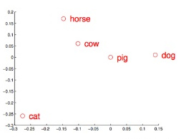
Embedding Text and Image Onto Same Space
Should the vectors coincide?

Slide 7
Revised Hypothesis: Image Understanding is only as powerful as the annotations we have and the capability of language understanding

Slide 8
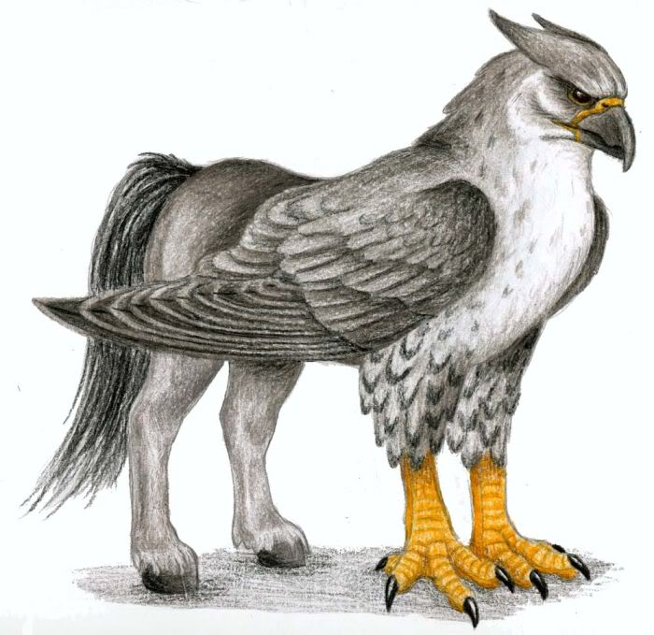
Exercise
This is a fictional creature: “hippogriff”.
Say, you have only 10-15 labeled images.
How can you build a classifier for this “object”?
Hint: What if you had an embedding for the word.
Hint: Zero-shot Learning

Slide 9
Scene Understanding Using Language
Caption Generation
Deep Captioning from Images
Dense Captioning
Caption Generation from Videos
Intermediate Semantic Representation
Background Technologies
RNN/LSTM to understand language, CNN to understand image

Slide 10
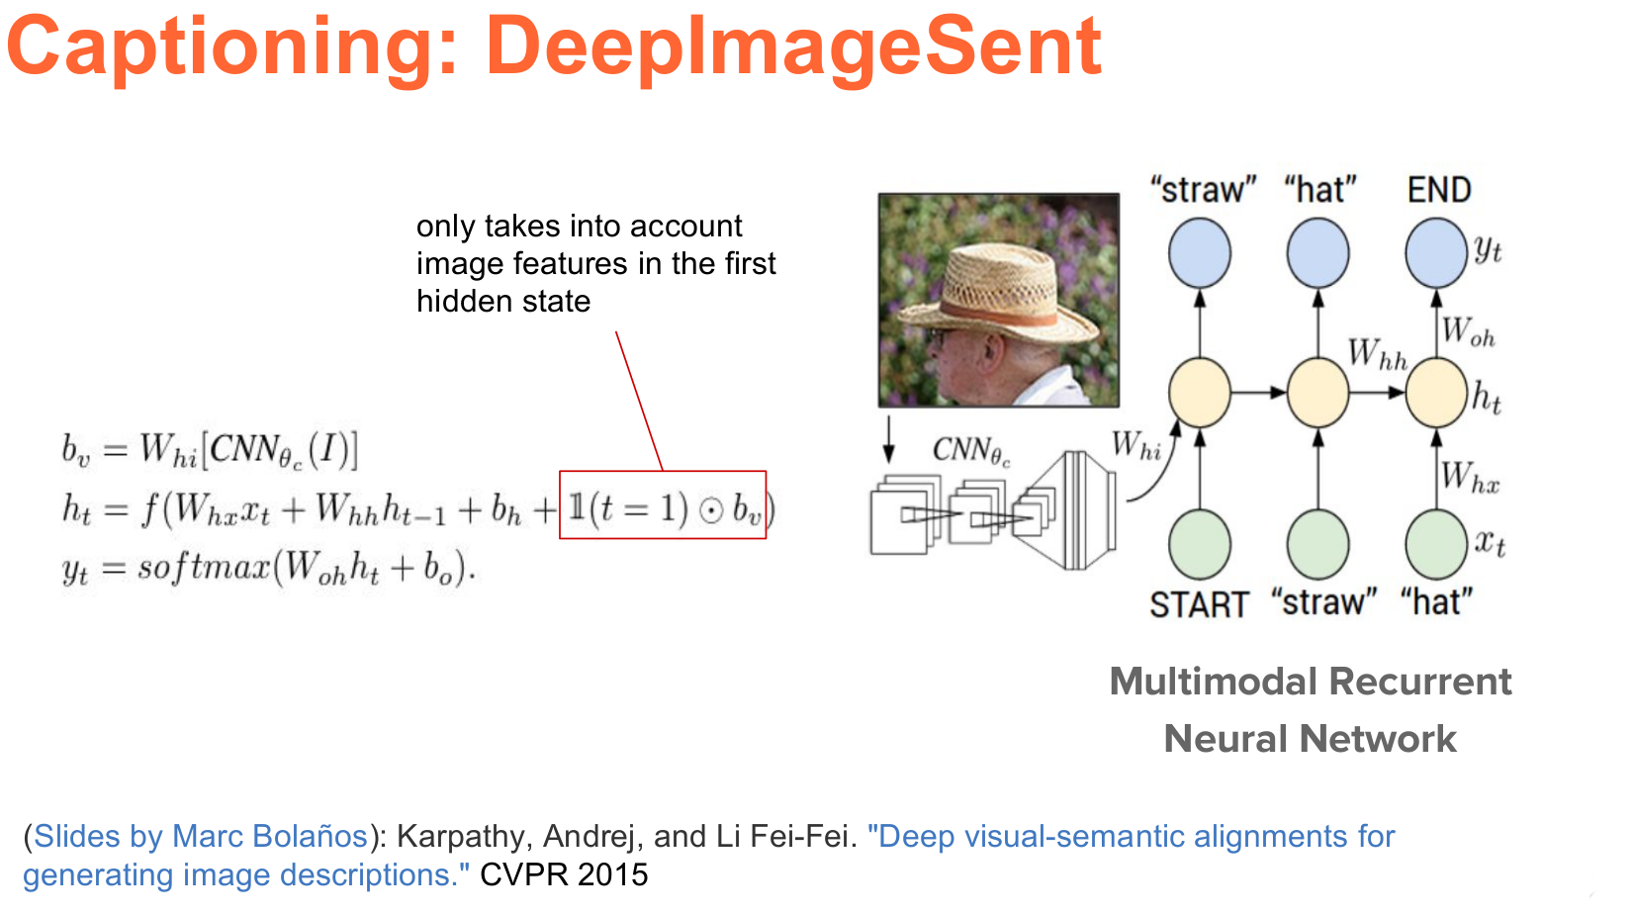
Ellman’s RNN Trick:
Given (x_{t},h_{t-1}) → Predict h_{t} → Predict y_{t}
Their Trick: use (x₁,h₀,Img ) to predict h₁
Notes:
Trained to combine (x_t, h_{t-1}) and predict next word y_t

Slide 11
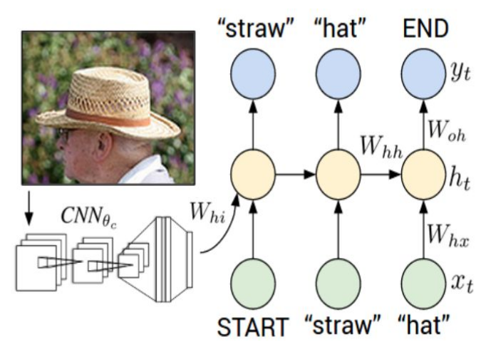
A Simpler Picture
Elman’s RNN: predict next word (y_{t}), given the current word (x_{t}) and the context(h_{t-1})

Slide 12
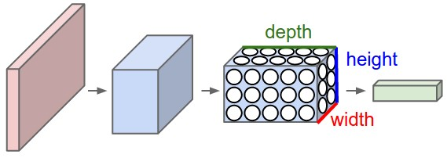
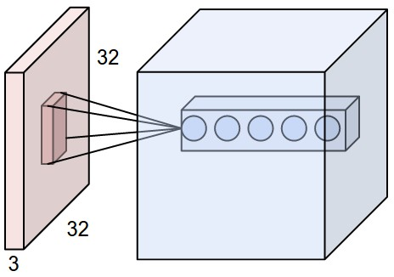
A bit of Background: CNN
A ConvNet arranges its neurons in three dimensions (width, height, depth).
Every layer of a ConvNet transforms the 3D input volume to a 3D output volume of neuron activations.
In this example, the red input layer holds the image, so its width and height would be the dimensions of the image, and the depth would be 3 (Red, Green, Blue channels).

Slide 13

Convolution Operation Example
Notes:
Image: 10x10x3. Just one filter Dimension: 5x5x3. Step=1, Output: 6x6x1
Another filter: Same dimension 6x6x2.

Slide 14
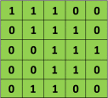

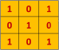
Convolution Operation Example (Numerical)
Convolution
(with stride=1)
Filter
Simple Raw Image
Dim.s: Conv( 5x5, 3x3, stride=1) ⇒ 3x3 = (5-3+1)x(5-3+1)
Notes:
Image: 5x5. Just one filter Dimension: 3x3. Step-size=1, Output: 3x3x1
Another filter: Same dimension 3x3x2.

Slide 15
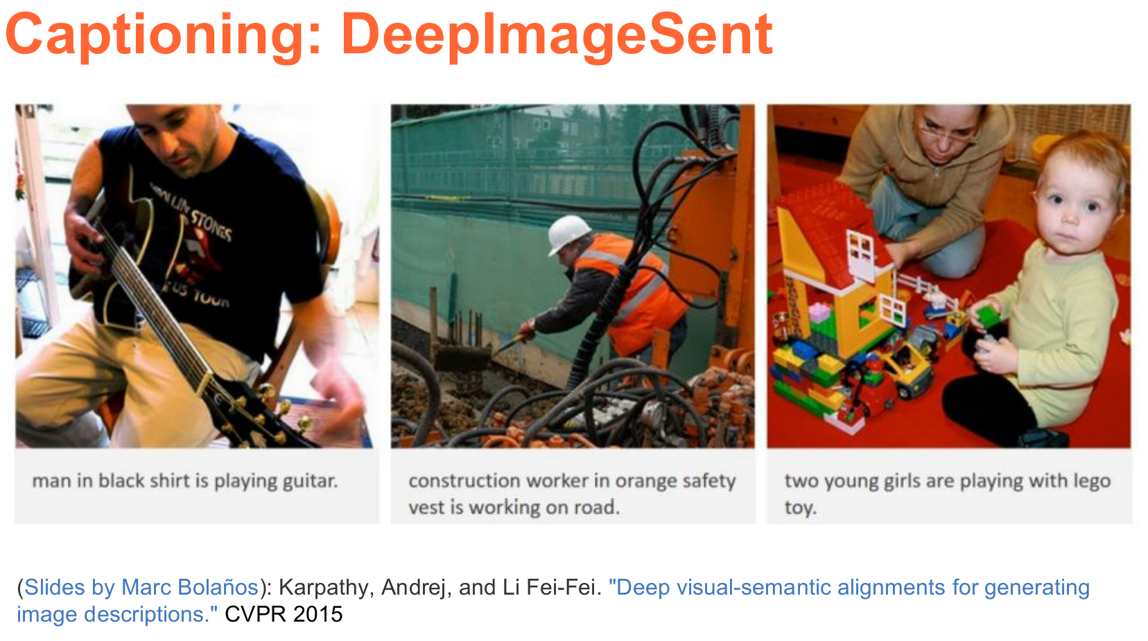

Slide 16
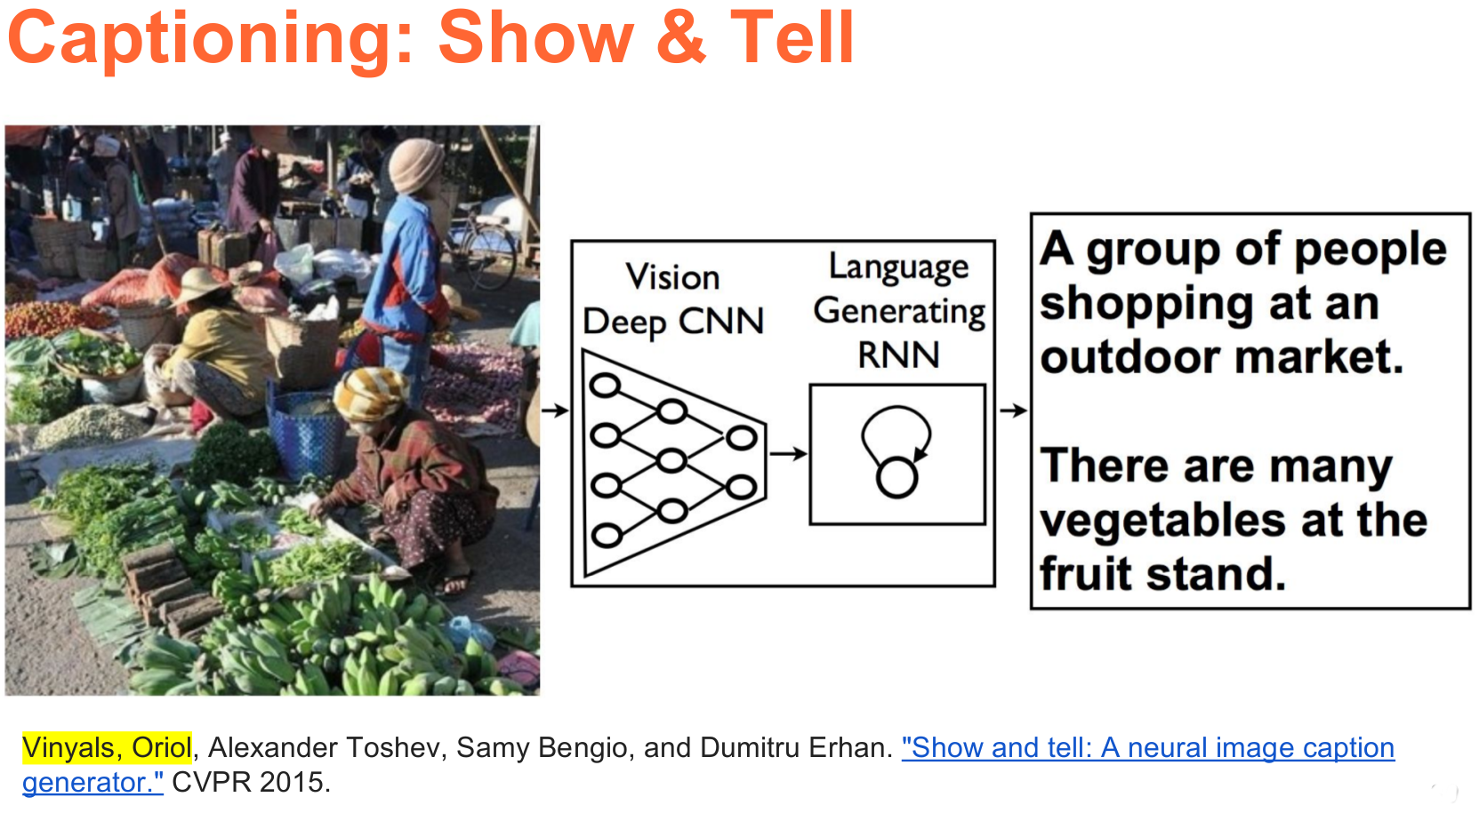
Notes:
Only difference here: is using LSTM

Slide 17
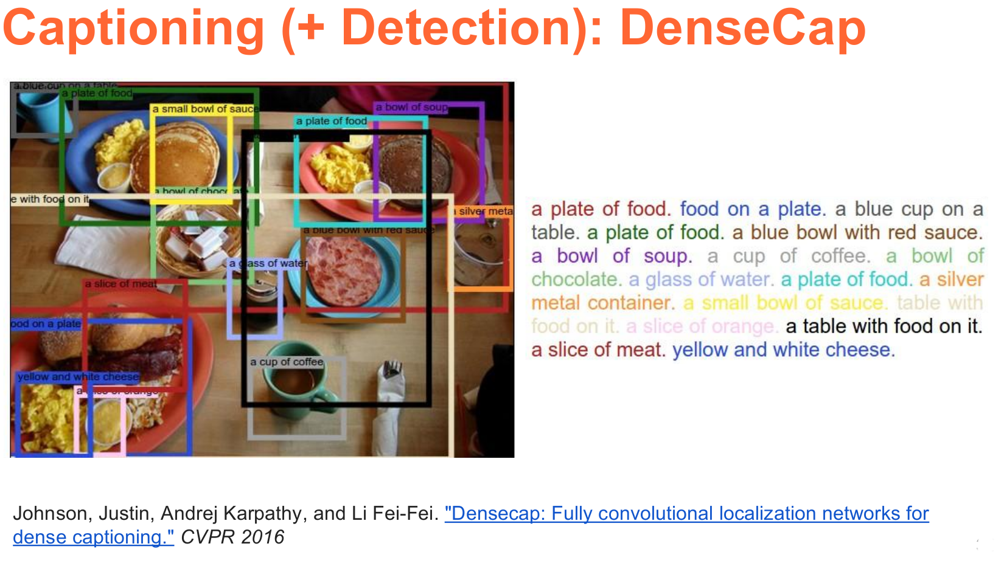

Slide 18
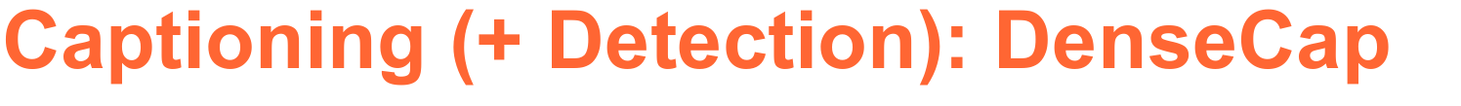
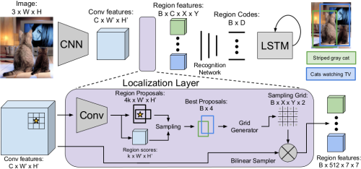
Task: Localize and describe salient Regions
Get Convolutional Features: CxW’xH’
Localization (say 12 regions):
3D matrix for each region
Generate Caption using LSTM

Slide 19
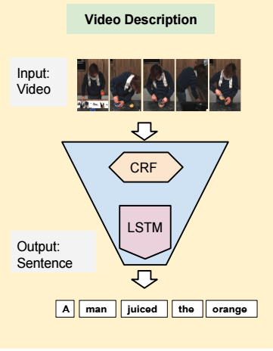
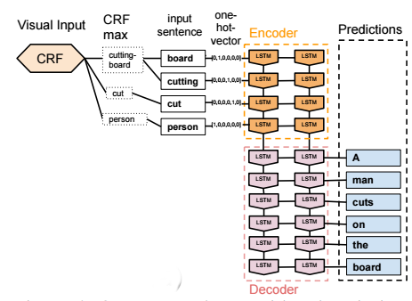
Captioning: LSTM for Videos (Donahue 2014)
Given an Image, the CRF outputs:
<person, cut, cutting-board>
<subject, action, object>
Using that, generate Sentences.
LSTM ≅ NLG

Slide 20
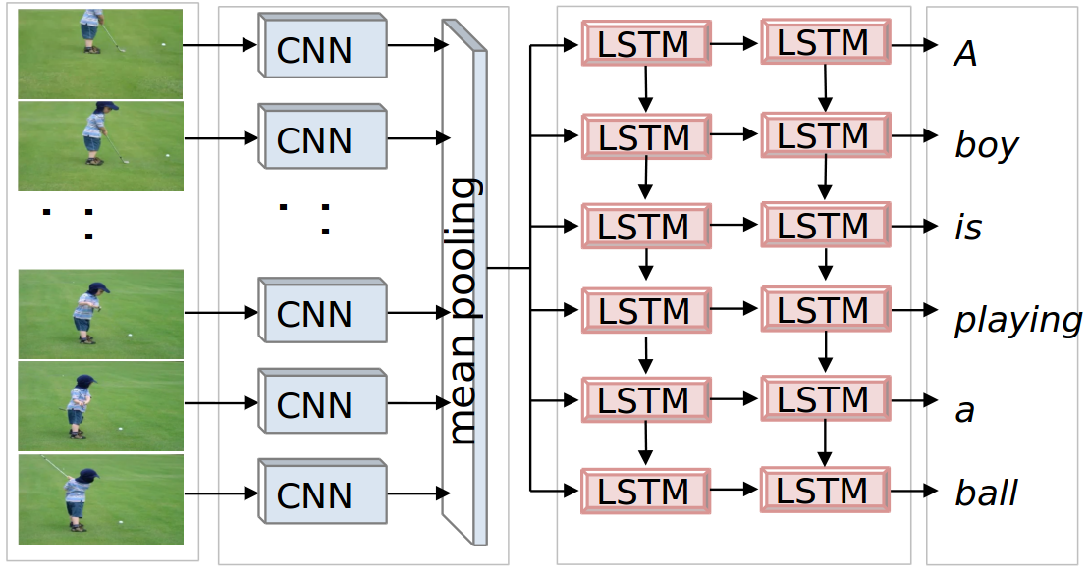
Captioning: LSTM for Videos (Donahue 2014)

Slide 21
Semantic Representations
Scene Graph
Scene Description Graph

Slide 22
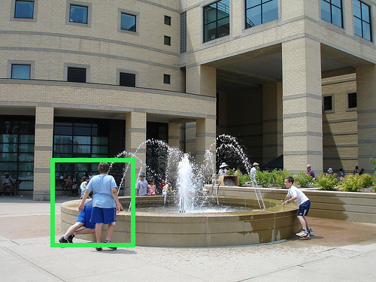
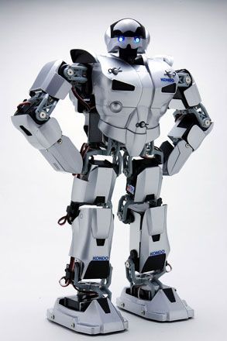
A meaningful Semantic Representation
Scene Graph /
Scene Desc. Graph
A man is standing near a fountain outside a building...
NLG
(Probabilistic) Logical Languages
Text Space
Is a person drinking from the fountain?
Image Space
Yes
Image Retrieval
QA/Reasoning space

Slide 23
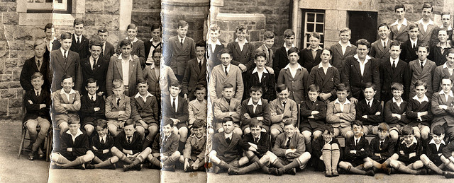
Why do we need it?
An output from a state-of-the-art Neural Caption Generator
Generated Annotation (CNN): A bunch of bananas is hanging from a ceiling.

Slide 24
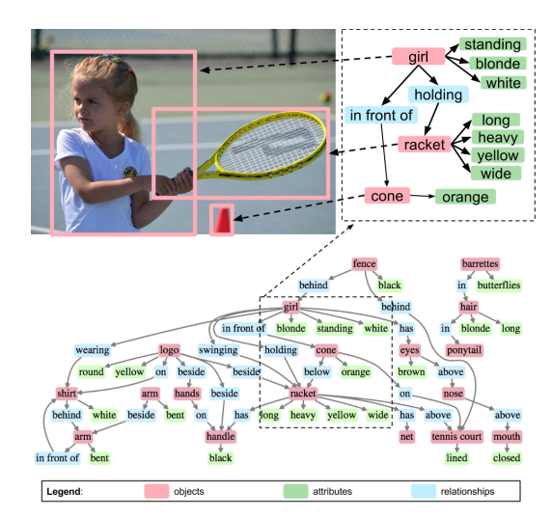
Scene Graphs (Johnson CVPR2015)
Nodes: objects, regions
Relationships: verbs, prepositions
Objects: adjectives, adverbs

Slide 25
Scene Description Graphs (Aditya2016, ACS)
What could be a possible advantage?
Nodes: Entity/Event/Constituent
Entity: objects, Events: verbs, constituent: “concepts/phrases”
Relationships: from K-Parser relations (Well-defined Ontological Relations)

Slide 26
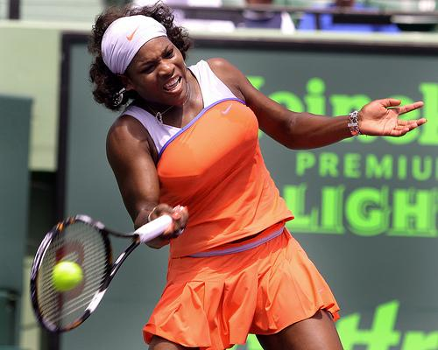
SDG: Motivating QA Example
Is someone playing tennis?
SDG
entity(person;racket;shorts;shirt).
animate(person;dog).
inanimate(A) :- not animate(A), entity(A).
tennis_detector :- has(swing,recipient,racket), has(racket,complement_phrase,tennis),has(swing,agent,A),animate(A).
has(hold,location,scene).
has(hold,recipient,racket).
has(hold,agent,person).
has(swing,location,scene).
has(swing,recipient,racket).
has(swing,agent,person).
has(shirt,semantic_role,:clothing).
has(sweatband,semantic_role,:clothing).
has(racket,complement_phrase,tennis).
has(racket,semantic_role,:thing held).
has(person,trait,female).
has(person,semantic_role,:holder).
Detections
ASP Reasoning Engine
Person, racket, popsickle, brassiere
stadium, baseball_field
outdoors, outside, sky
tennis_detector=True

Slide 27
Understanding images and text
Visual Question Answering
General VQA
Knowledge-based VQA
Image Puzzle Solving

Slide 28
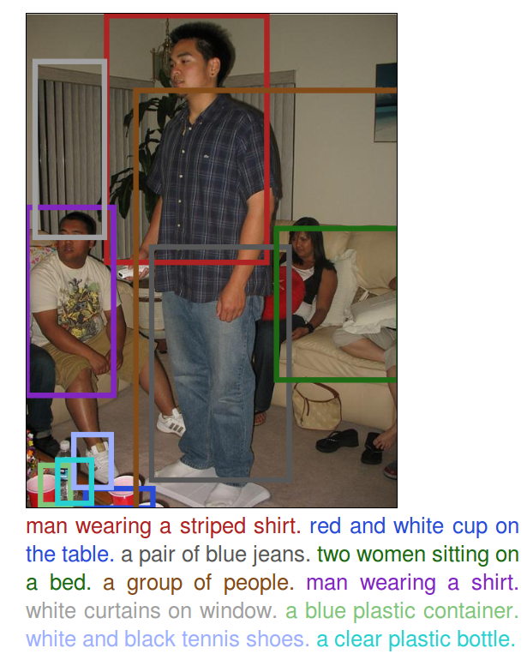
Visual Question Answering
What is AI-complete task?
(wiki) the most difficult problems in AI: Nat. Lang. Understanding, Scene Understanding.
VQA requires both to be solved.
Image
?
Answer
White
What is the color
Of the sofa?
Question

Slide 29
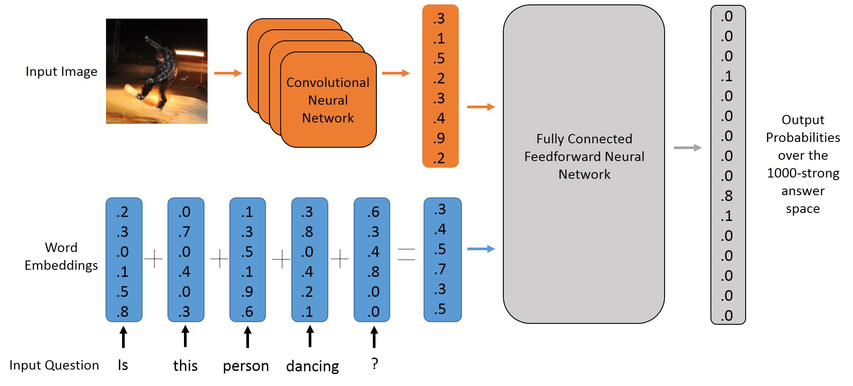
VQA: Simplest NN-based Architectures

Slide 30
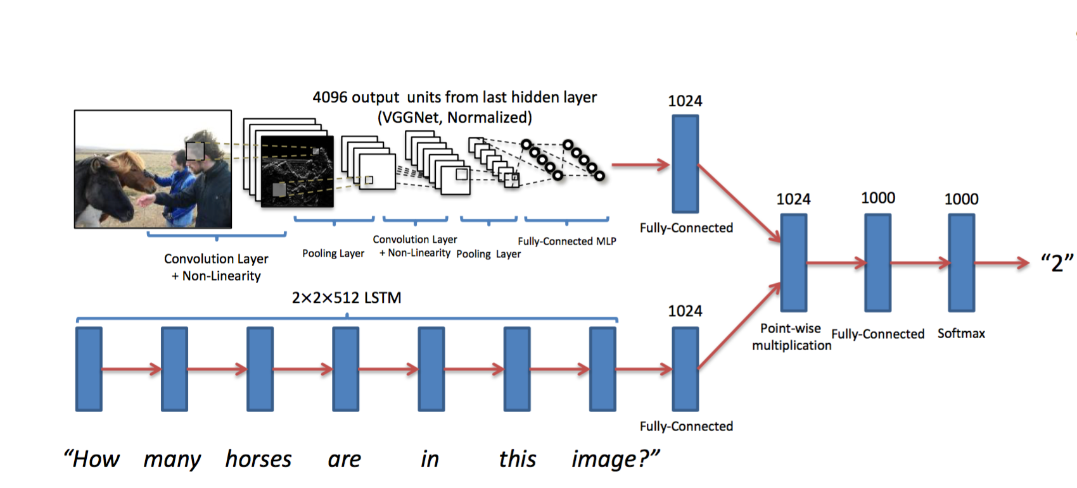
VQA: Proposed Models (VQA Antol et. al. 2015)

Slide 31
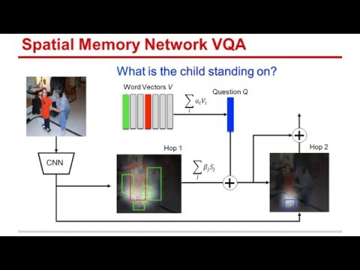
Spatial Memory Network VQA (Attention)

Slide 32
VQA: Do we just keep tweaking NNs?
What are the current flaws:
Assumption: Closed Set of Possible Answers
Question: How many hands are raised?
Answer: Could be any natural number.
Attention could do the trick. But, how do you understand “raised”?
Blindly scoring all answers: You can see yes/no as an answer to the above question.
Lack of Explicit Commonsense Reasoning: Does the man have 20-20 vision?
How do you explain the answer (wrong or right)? (Explainability)
Mathematically explaining vs. logically to a naive person.

Slide 33
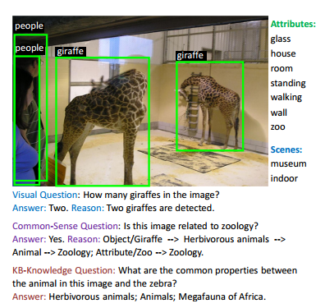
Attempting Flaw 3: Knowledge-Based VQA
Main Idea: Use explicit Knowledge Based Reasoning
Question: Is this image related to zoology?
Answer: Yes. Reason: Object/Giraffe --> Herbivorous animals --> Animal --> Zoology; Attribute/Zoo --> Zoology

Slide 34
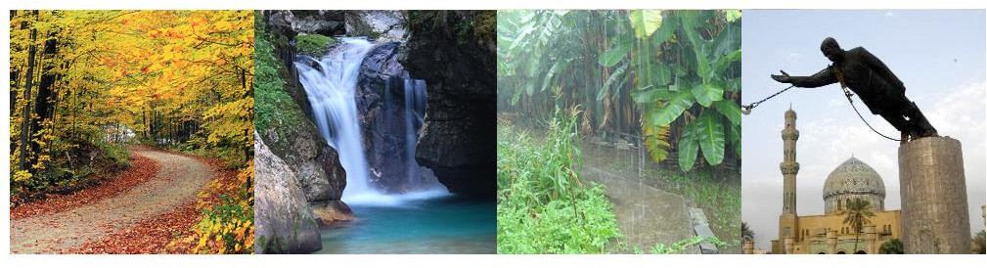
Attempting Flaws 3 and 4: Image Riddles
What word (logically) connects these images?
Answer:

Slide 35
Attempting Flaws 3 and 4: Image Riddles
What word (logically) connects these images?
Answer: Fall
Reason: The Fall Season, waterfall, rainfall, statue falling

Slide 36
Our Architecture (Our paper UAI 2018)
We use a combination of
Deep Learning.
Knowledge-Sources (ConceptNet, word2vec)
Probabilistic Soft Logic

Slide 37
Conclusion/Takeaway
Different perspectives of Image Understanding
What does Image understanding mean:
Caption image
Caption a video
Answer a question given an image
Answer puzzles
The technologies’ overview:
RNN/LSTM, Attention
CNN (convolution operation)

